Slide 1
Weather vs Home Sales in King County, WA
Data Analytics Bootcamp - API Group Project
Kaveh Amini, Yashwinie Shivanand, Yinka Adesanmi

Slide 2
Research question
Is there a relation between residential real estate sales and the weather?
To start, we aimed to examine the relationship between prices and numbers of home sales, and how these correlate to weather.
Does a relationship exist?
What is the nature of that relationship?
Notes:
* Define the core message or hypothesis of your project.
* Describe the questions you asked, and _why_ you asked them
* Describe whether you were able to answer these questions to your satisfaction, and briefly summarize your findings

Slide 3
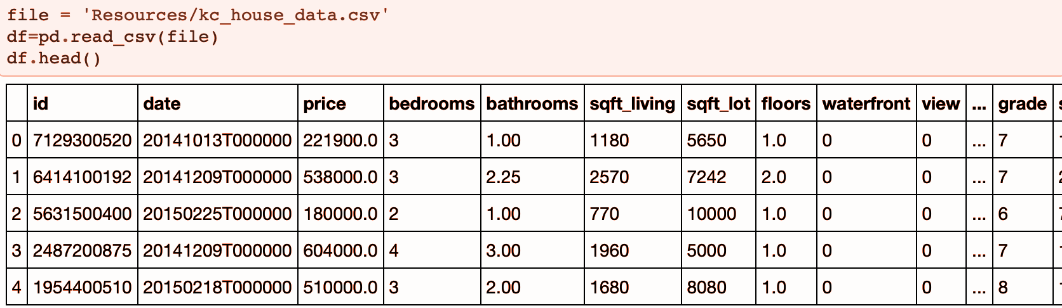
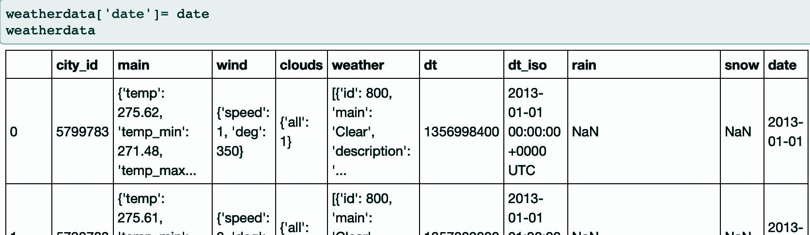
Data
We used two datasets for this analysis:
OpenWeather Historical Data
King County Real Estate Sales (May-2014 to May-2015)
Notes:
Elaborate * Questions & Data
* Elaborate on the questions you asked, describing what kinds of data you needed to answer them, and where you found it
* Data Cleanup & Exploration
* Describe the exploration and cleanup process
* Discuss insights you had while exploring the data that you didn't anticipate
* Discuss any problems that arose after exploring the data, and how you resolved them
* Present and discuss interesting figures developed during exploration, ideally with the help of Jupyter Notebook

Slide 4
Data analysis
Finding the datasets
The house sales dataset was found as a csv file on Kaggle.com
The historic weather data were obtained from open weather map as a json file
Data clean up
Normalized the dates on two datasets to the format of yyyy-mm-dd so that they could be merged on date
Extracted the data required from json dictionaries and removed the unnecessary columns
Data analysis
Analyzed the data for any correlation between weather conditions and house sales/prices
Analyzed the house sales dataset for any correlation between hose prices and the conditions of the house
Notes:
* Discuss the steps you took to analyze the data and answer each question you asked in your proposal
* Present and discuss interesting figures developed during analysis, ideally with the help of Jupyter Notebook → open and run through master jupyter notebook here

Slide 5
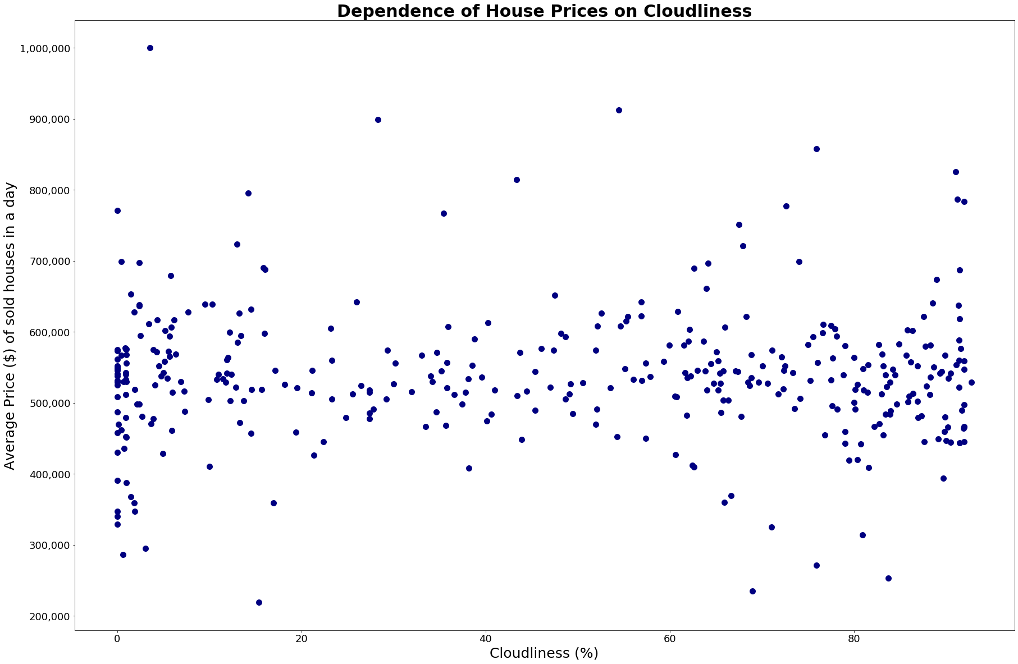
Findings
(1) No dependence found between house prices and cloudiness throughout the year.

Slide 6
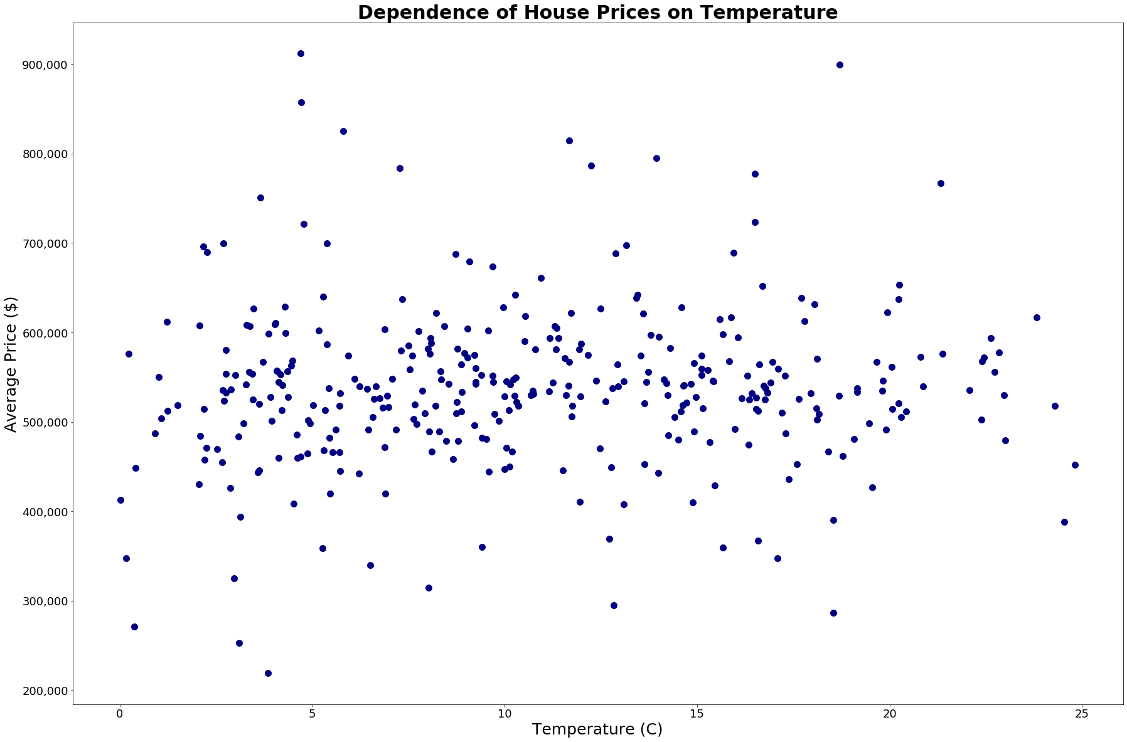
Findings
(2) No dependence found between house prices and temperatures throughout the year.

Slide 7
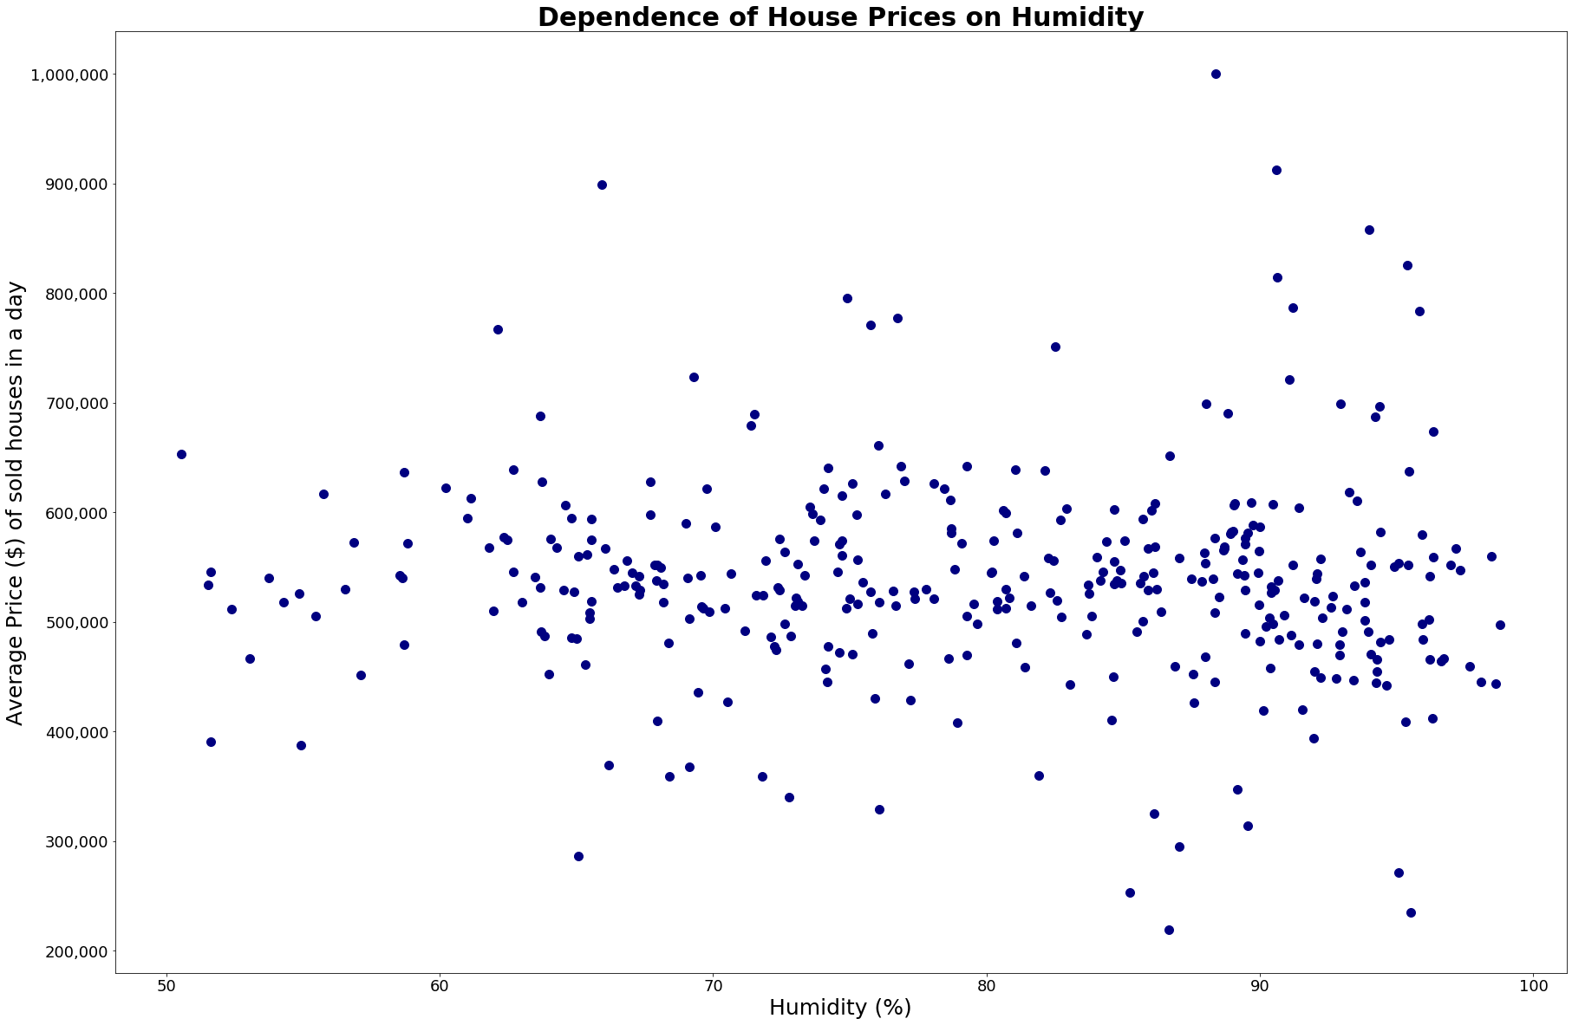
Findings
(3) Minimum/basically no dependence between house prices and humidity throughout the year.

Slide 8
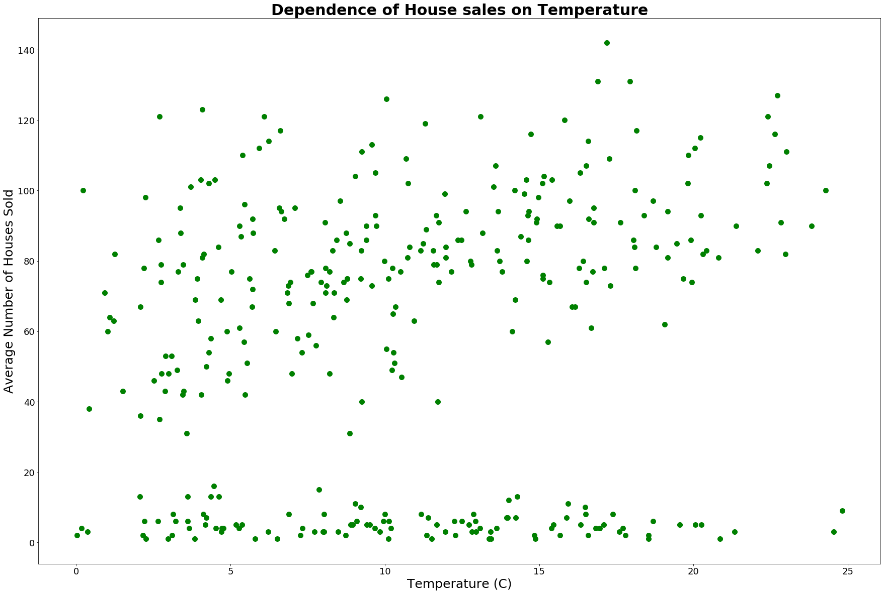
Findings
(4) No clear correlation between average number of houses sold and temperature, though two distinct populations appear.

Slide 9
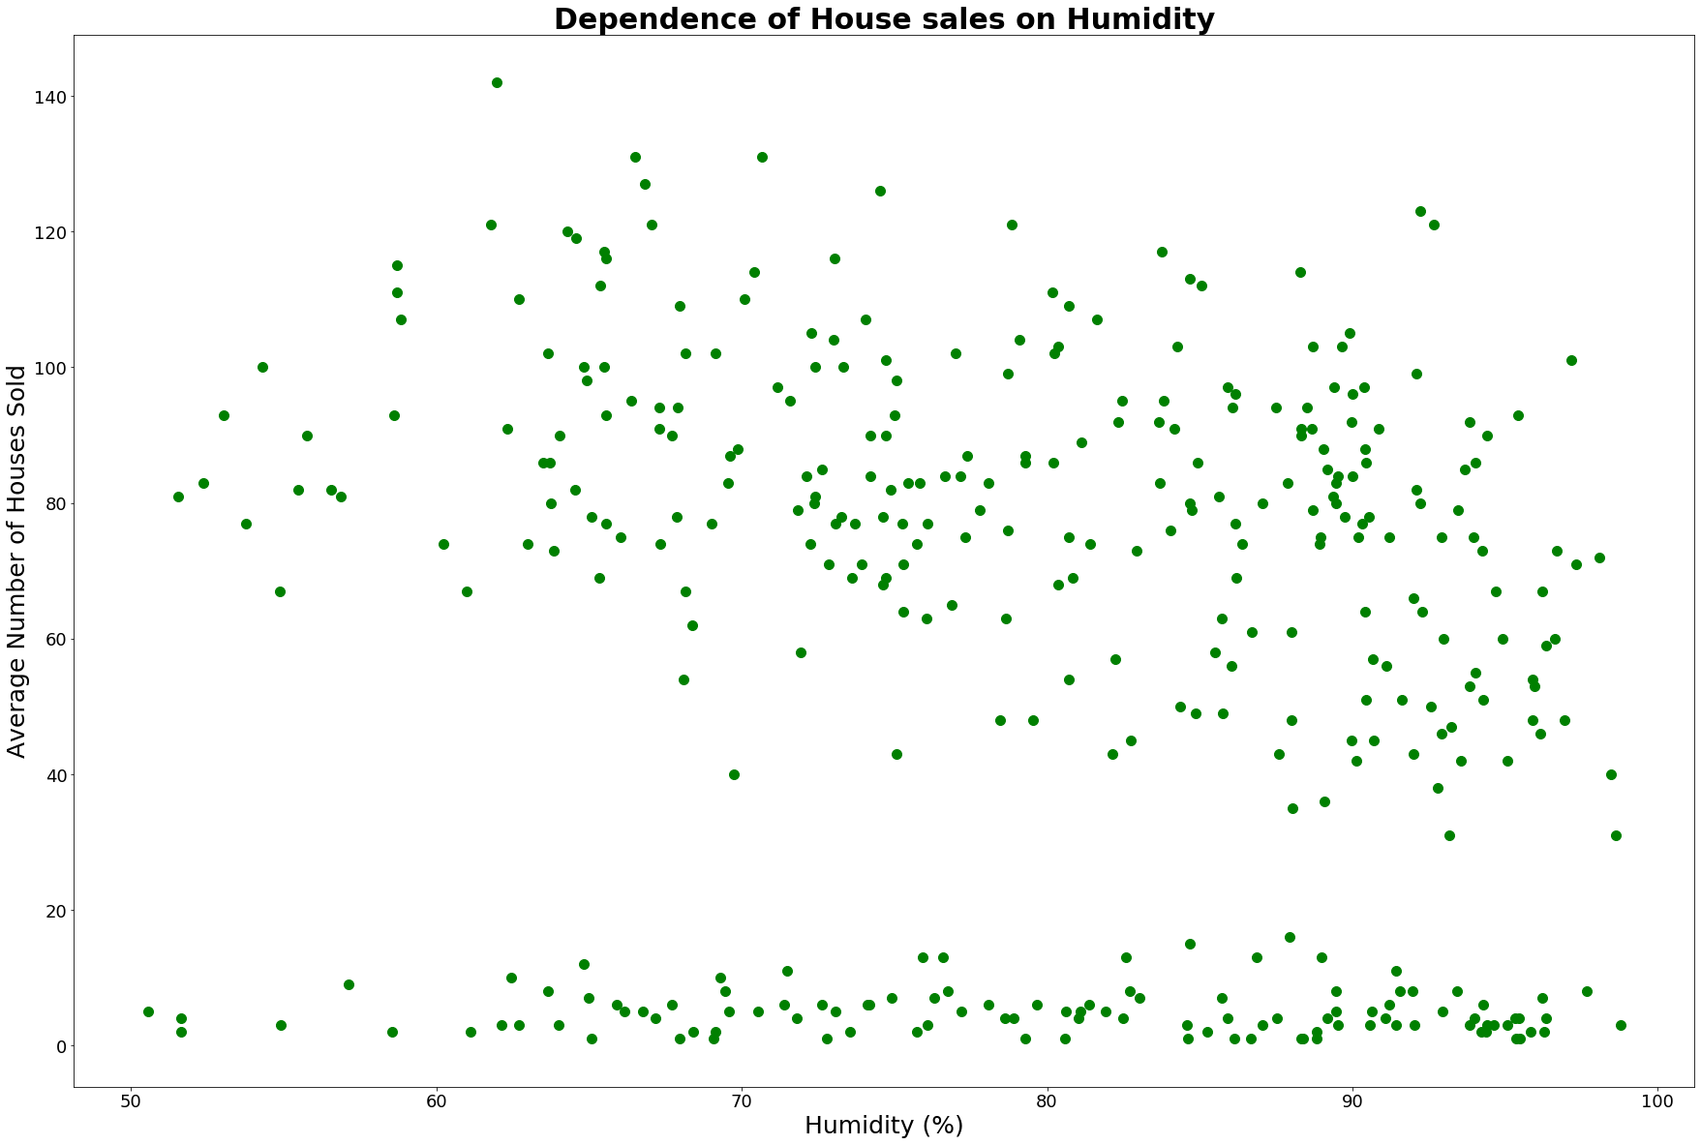
Findings
(5) No clear correlation between average number of houses sold and humidity. Two distinct populations appear again.

Slide 10
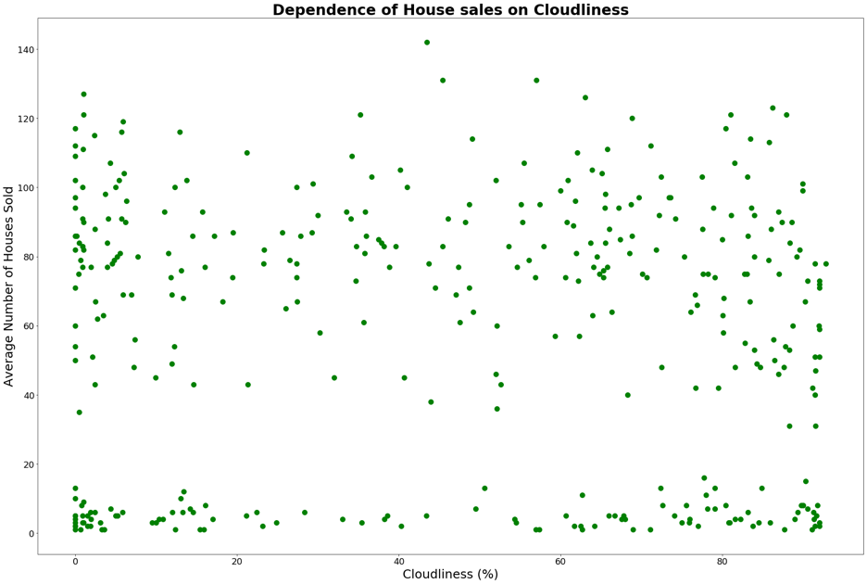
Findings
(6) No clear correlation between average number of houses sold and cloud cover. Two distinct populations appear again.

Slide 11
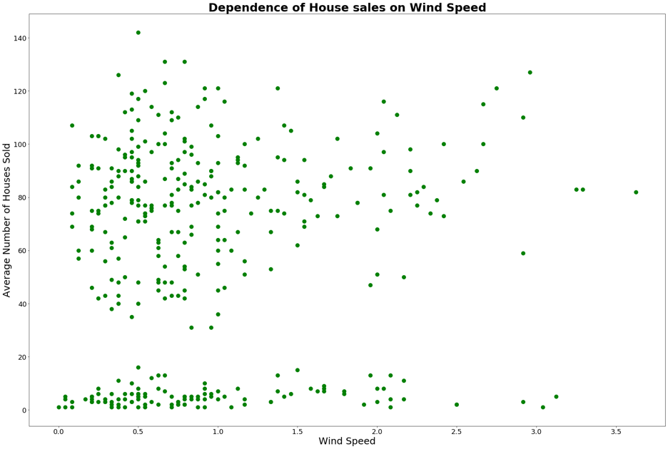
Findings
(7) Minimum/basically no correlation between average number of houses sold and wind speed. Two distinct populations appear again.

Slide 12
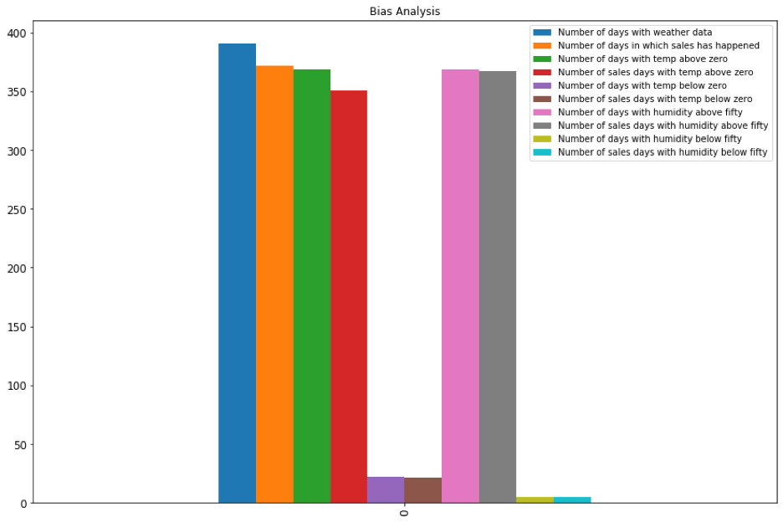
Findings
(8) Bias Analysis

Slide 13
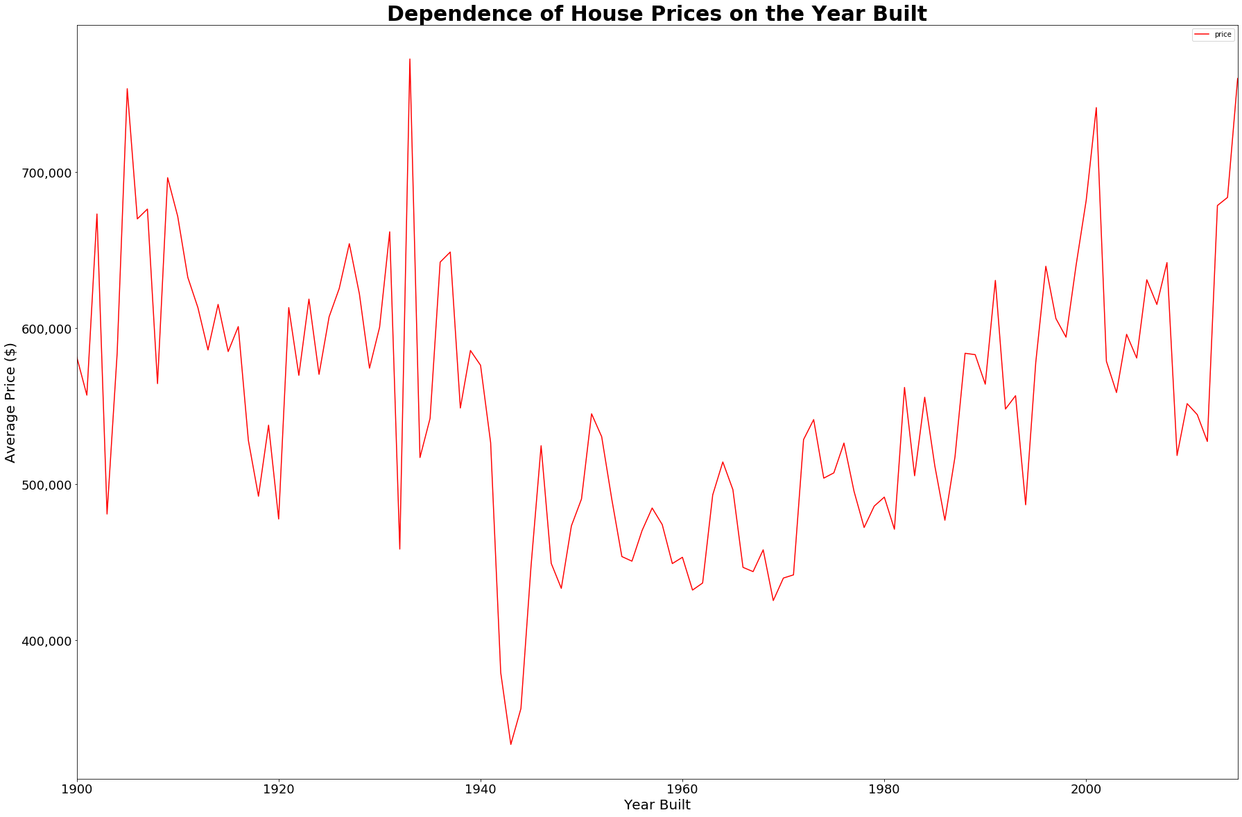
Findings
(9) Some correlation between when houses are built and its selling price.

Slide 14
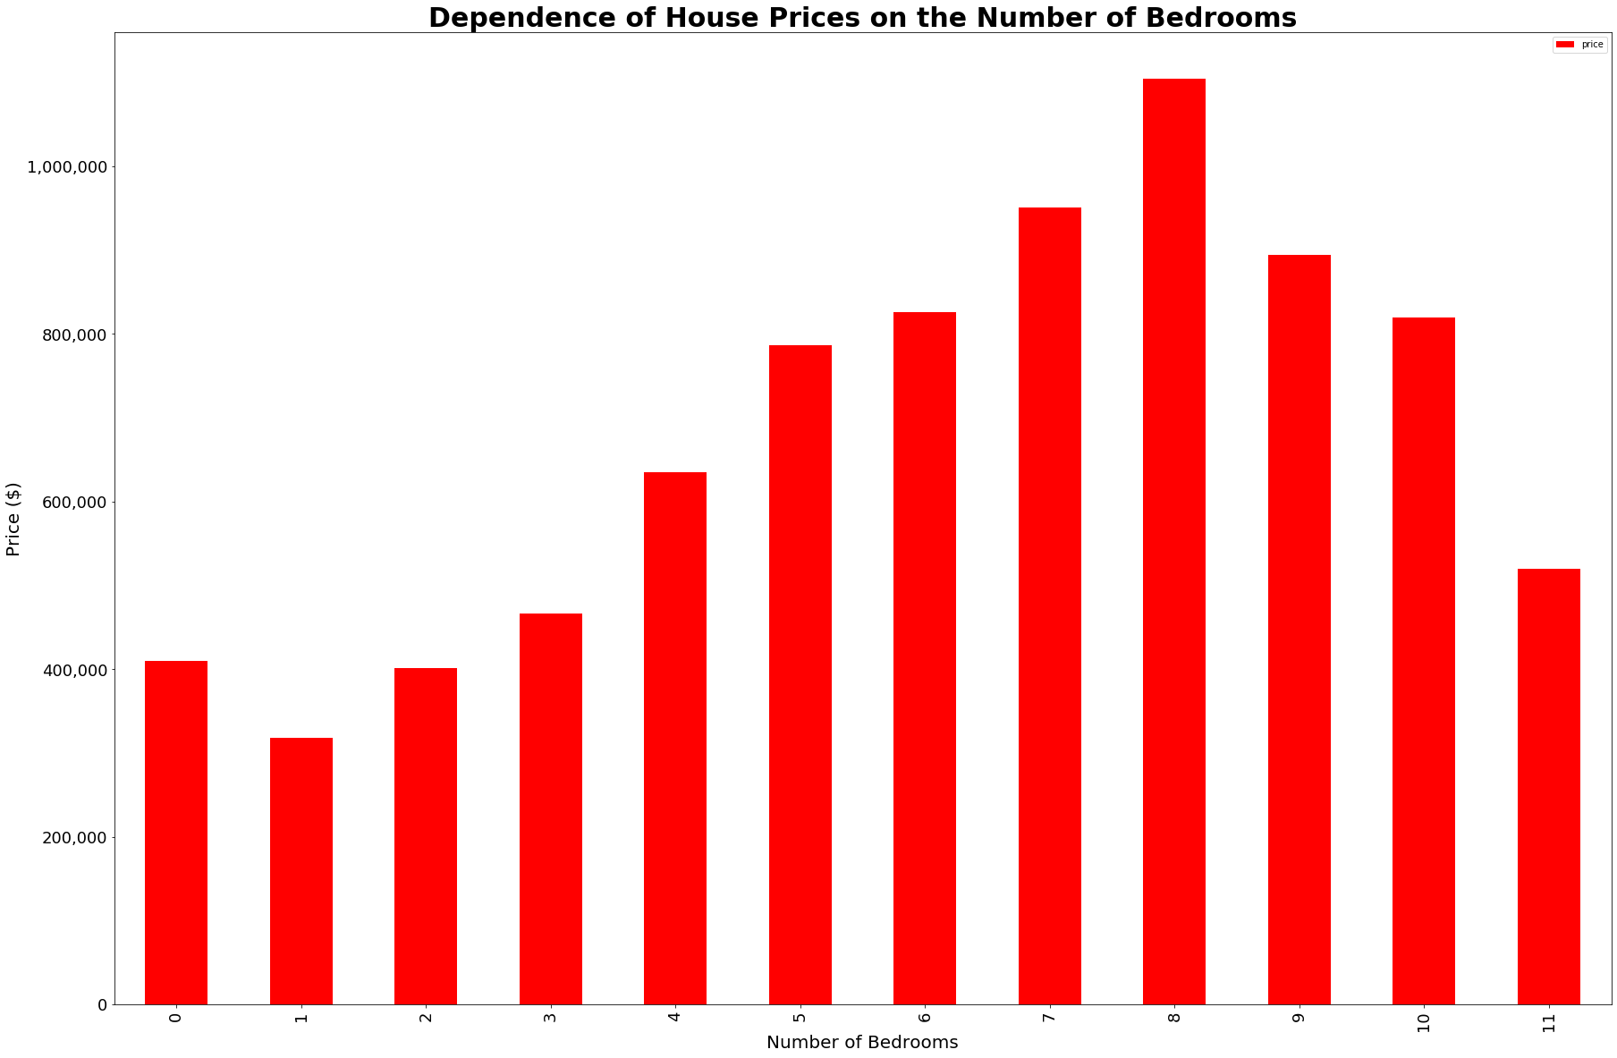
Findings
(10) Some common sense findings when plotting house selling price against its number of bedrooms.

Slide 15
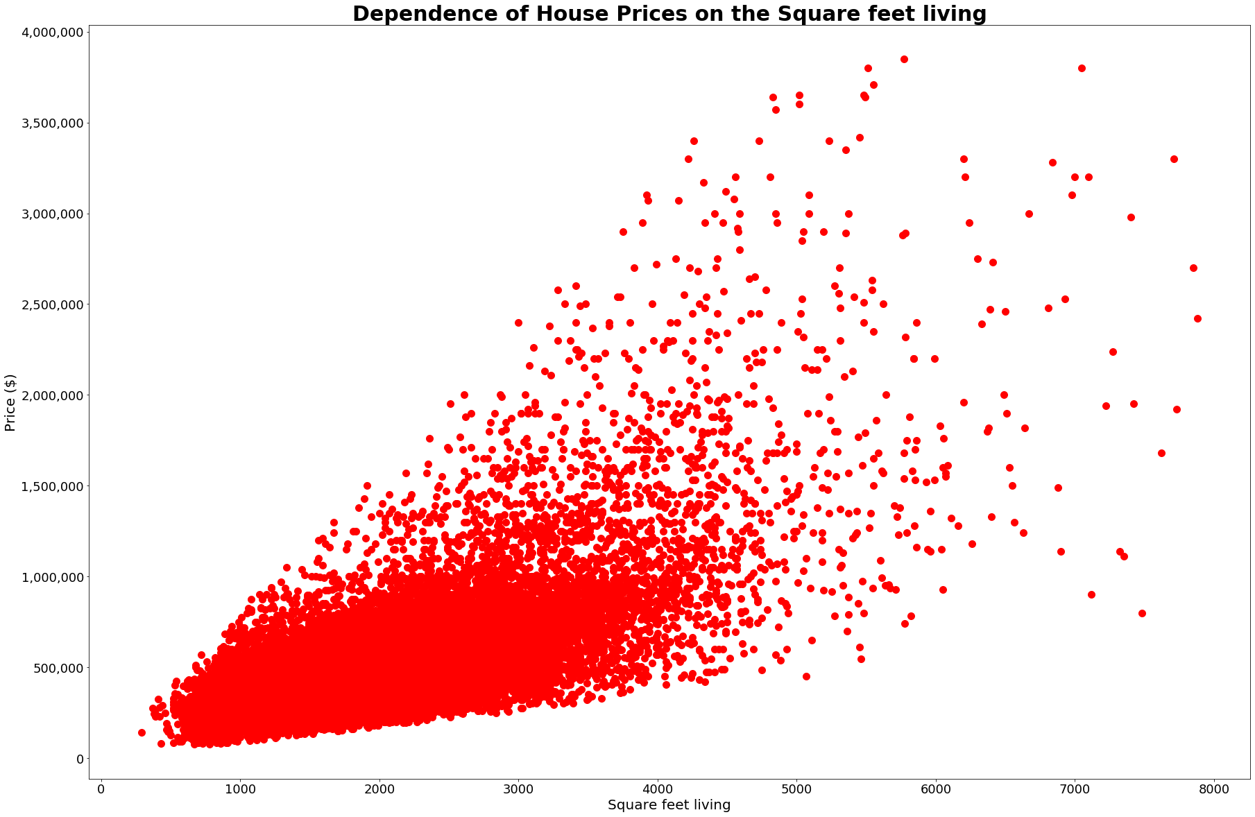
Findings
(11) A clear pattern emerges between house sizes and house selling price.

Slide 16
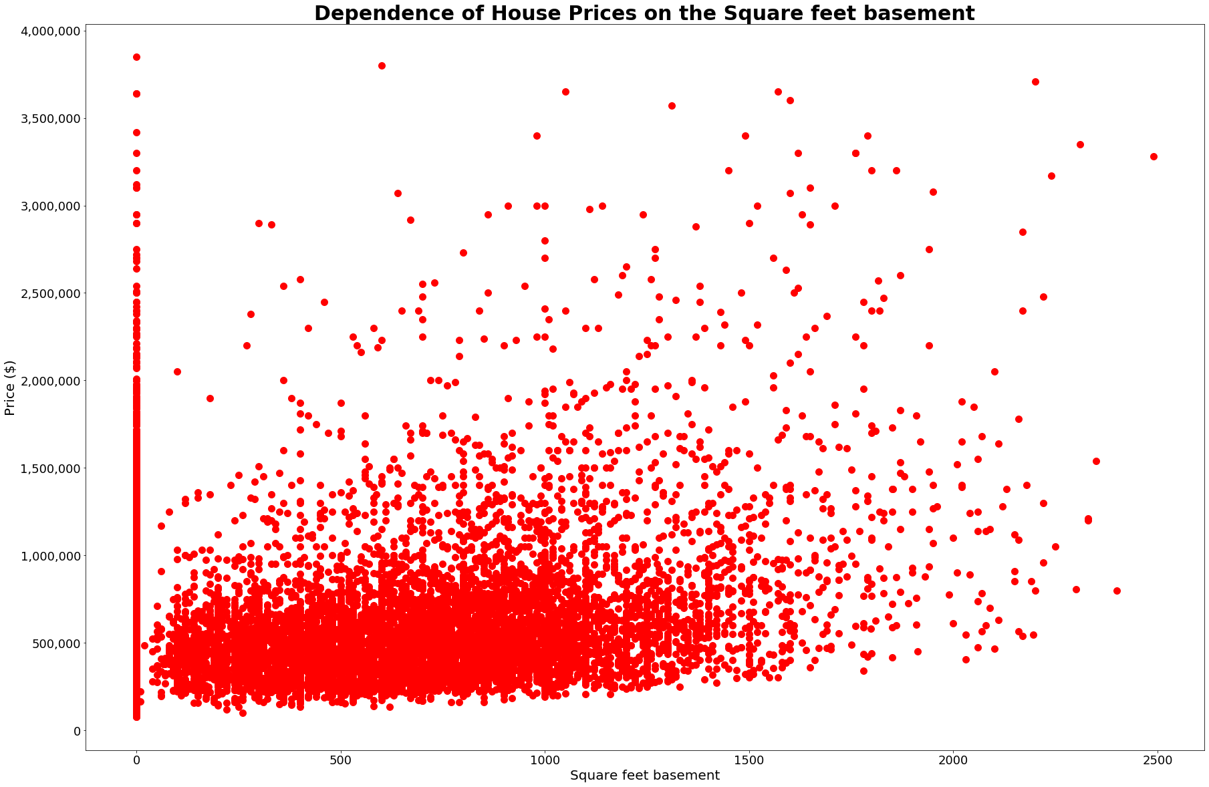
Findings
(12) Clear correlation between house prices and the square feet of its basement.

Slide 17
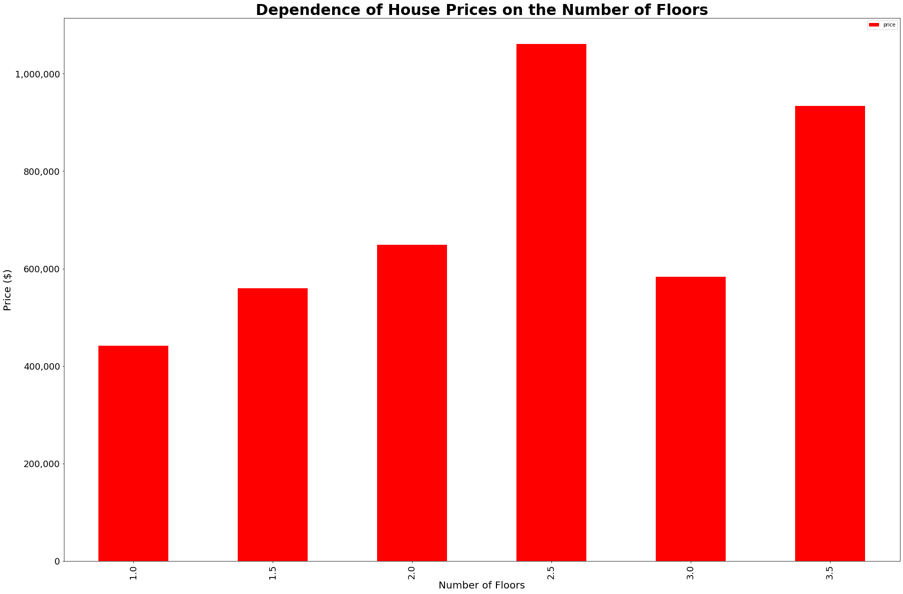
Findings
(13) Dependence between house prices and the number of floors of that house.

Slide 18
Conclusions
Post-mortem thoughts
Notes:
* Discuss any difficulties that arose, and how you dealt with them
*Discuss any additional questions that came up, but which you didn't have time to answer: What would you research next, if you had two more weeks?

Slide 19
Questions?

